Slide 1

CMPT310: Artificial Intelligence
Constraints Satisfaction Problems(CSP)
[slides partially adapted from Dan Klein, Pieter Abbeel, Stuart Russel, Dawn Song from University of California]
Notes:
Please retain proper attribution, including the reference to ai.berkeley.edu. Thanks!

Slide 2

Constraint Satisfaction Problems
N variables
domain D constraints
x₂
x₁
states
partial assignment
goal test
complete; satisfies constraints
successor function
assign an unassigned variable

Slide 3


What is Search For?
Assumptions about the world: a single agent, deterministic actions, fully observed state, discrete state space, non-adversarial space
Planning: sequences of actions
The path to the goal is the important thing
Paths have various costs, depths
Heuristics give problem-specific guidance
Identification: assignments to variables
The goal itself is important, not the path
All paths at the same depth (for some formulations)
CSPs are specialized for identification problems

Slide 4


Constraint Satisfaction Problems
Standard search problems:
State is a “black box”: arbitrary data structure
Goal test can be any function over states
Successor function can also be anything
Constraint satisfaction problems (CSPs):
A special subset of search problems
State is defined by variables X_{i} with values from a domain D (sometimes D depends on i)
Goal test is a set of constraints specifying allowable combinations of values for subsets of variables
Simple example of a formal representation language
Allows useful general-purpose algorithms with more power than standard search algorithms
Notes:
Goal test has structure, it ‘s more like a manual describing a set of constraints that have to hold true

Slide 5
CSP Examples

Slide 6
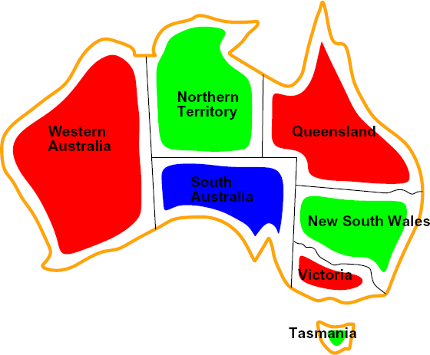


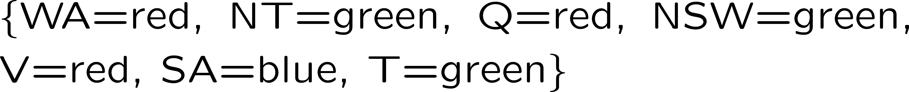
Example: Map Coloring
Variables:
Domains:
Constraints: adjacent regions must have different colors
Implicit:
Explicit:
Solutions are assignments satisfying all constraints, e.g.:

Slide 7
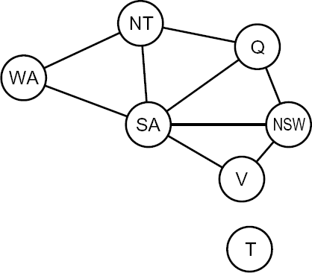
Constraint Graphs

Slide 8
Constraint Graphs
Binary CSP: each constraint relates (at most) two variables
Binary constraint graph: nodes are variables, arcs show constraints
General-purpose CSP algorithms use the graph structure to speed up search. E.g., Tasmania is an independent subproblem!

Slide 9


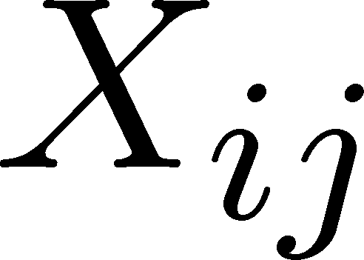

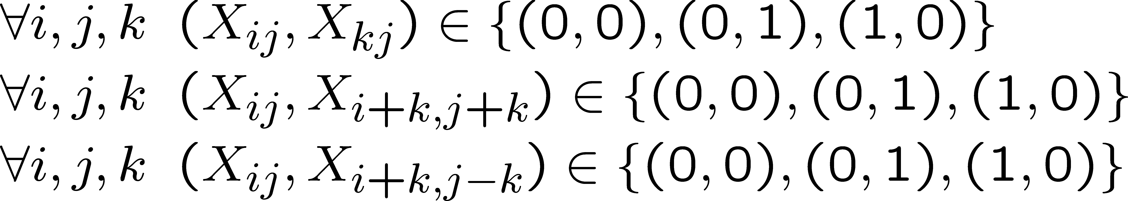
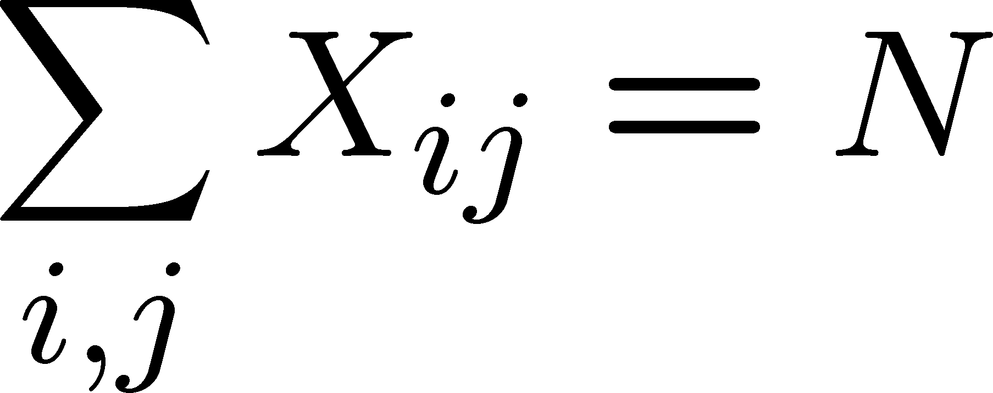
Example: N-Queens
Formulation 1:
Variables:
Domains:
Constraints

Slide 10








Example: N-Queens
Formulation 2:
Variables:
Domains:
Constraints:
Implicit:
Explicit:

Slide 11
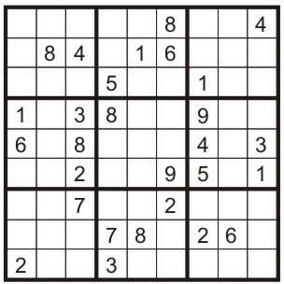
Example: Sudoku
Variables:
Each (open) square
Domains:
{1,2,…,9}
Constraints:
9-way alldiff for each column 9-way alldiff for each row
9-way alldiff for each region
(or can have a bunch of pairwise inequality constraints)

Slide 12


Varieties of CSPs
Discrete Variables
Finite domains
Size d means O(d^{n}) complete assignments
E.g., Boolean CSPs, including Boolean satisfiability (NP- complete)
Infinite domains (integers, strings, etc.)
E.g., job scheduling, variables are start/end times for each job
Linear constraints solvable, nonlinear undecidable
Continuous variables
E.g., start/end times for Hubble Telescope observations
Linear constraints solvable in polynomial time by LP methods (see cs170 for a bit of this theory)

Slide 13



Varieties of Constraints
Varieties of Constraints
Unary constraints involve a single variable (equivalent to reducing domains), e.g.:
Binary constraints involve pairs of variables, e.g.:
Higher-order constraints involve 3 or more variables: e.g., cryptarithmetic column constraints
Preferences (soft constraints):
E.g., red is better than green
Often representable by a cost for each variable assignment
Gives constrained optimization problems
(We’ll ignore these until we get to Bayes’ nets)

Slide 14
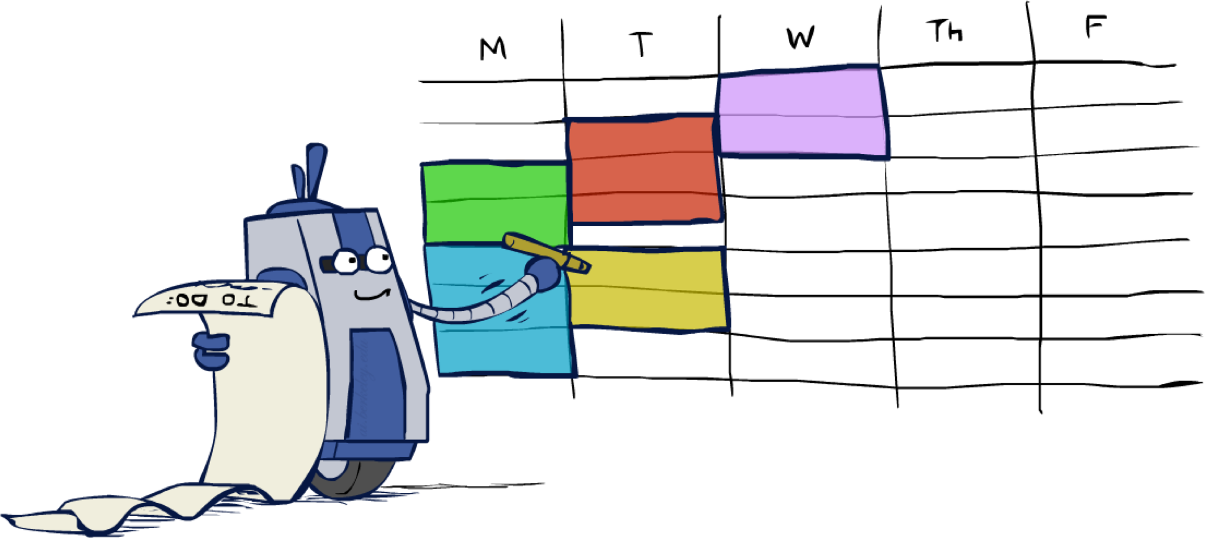
Real-World CSPs
Assignment problems: e.g., who teaches what class
Timetabling problems: e.g., which class is offered when and where?
Hardware configuration
Transportation scheduling
Factory scheduling
Circuit layout
Fault diagnosis
… lots more!
Many real-world problems involve real-valued variables…

Slide 15

Standard Search Formulation
Standard search formulation of CSPs
States defined by the values assigned so far (partial assignments)
Initial state: the empty assignment, {}
Successor function: assign a value to an unassigned variable
Goal test: the current assignment is complete and satisfies all constraints
We’ll start with the straightforward, naïve approach, then improve it

Slide 16
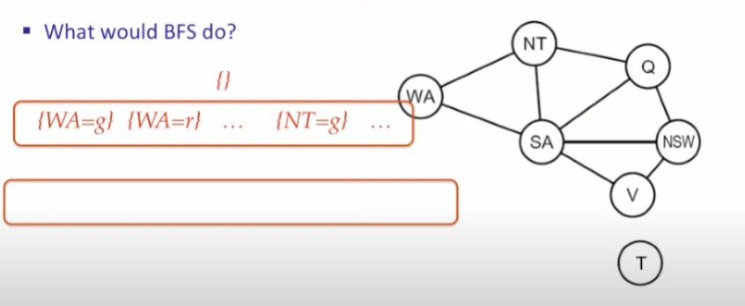
Naïve BFS or DFS won’t work:

Slide 17

Backtracking Search

Slide 18
Backtracking Search
Backtracking search is the basic uninformed algorithm for solving CSPs
Idea 1: One variable at a time
Variable assignments are commutative, so fix ordering
I.e., [WA = red then NT = green] same as [NT = green then WA = red]
Only need to consider assignments to a single variable at each step
Idea 2: Check constraints as you go
I.e. consider only values which do not conflict previous assignments
Might have to do some computation to check the constraints
“Incremental goal test”
Depth-first search with these two improvements
is called backtracking search (not the best name)
Can solve n-queens for n ≈ 25

Slide 19
Backtracking Example

Slide 20
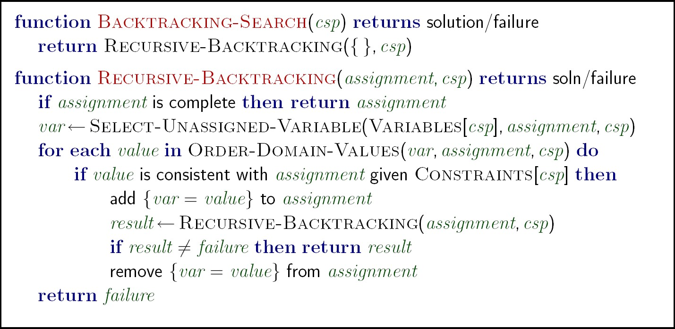



Backtracking Search
Backtracking = DFS + variable-ordering + fail-on- violation
What are the choice points?
Demos: https://inst.eecs.berkeley.edu/~cs188/fa21/assets/demos/csp/csp_demos.html

Slide 21

Improving Backtracking
General-purpose ideas give huge gains in speed
Ordering:
Which variable should be assigned next?
In what order should its values be tried?
Filtering: Can we detect inevitable failure early?
Structure: Can we exploit the problem structure?

Slide 22

Filtering

Slide 23
Filtering: Forward Checking
Filtering: Keep track of domains for unassigned variables and cross off bad options
Forward checking: Cross off values that violate a constraint when added to the existing assignment
WA
NT
Q
SA
NSW
V
[Demo: coloring -- forward checking]
Notes:
Demo:
CS188 javascript demos -> source -> exercises -> csps -> CSPs demos -> CSPs demos.html
Settings:
Graph = Simple
Algorithm = Backtracking
Ordering = None
Filtering = Forward Checking

Slide 24

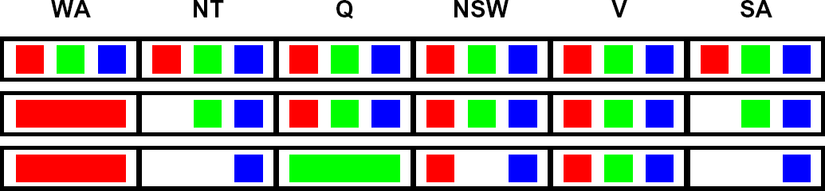

Filtering: Constraint Propagation
Forward checking propagates information from assigned to unassigned variables, but doesn't provide early detection for all failures:
NT
SA
Q
NSW
V
WA
NT and SA cannot both be blue!
Why didn’t we detect this yet?
Constraint propagation: reason from constraint to constraint

Slide 25



Consistency of A Single Arc
An arc X ® Y is consistent iff for every x in the tail there is some y in the head which could be assigned without violating a constraint
NT
SA
Q
NSW
V
WA
Forward checking?
Delete from the tail!
Enforcing consistency of arcs pointing to each new assignment

Slide 26

Arc Consistency of an Entire CSP
A simple form of propagation makes sure all arcs are consistent:
NT
SA
Q
NSW
V
WA
Important: If X loses a value, neighbors of X need to be rechecked!
Arc consistency detects failure earlier than forward checking
Can be run as a preprocessor or after each assignment
What’s the downside of enforcing arc consistency?
Remember: Delete from the tail!

Slide 27
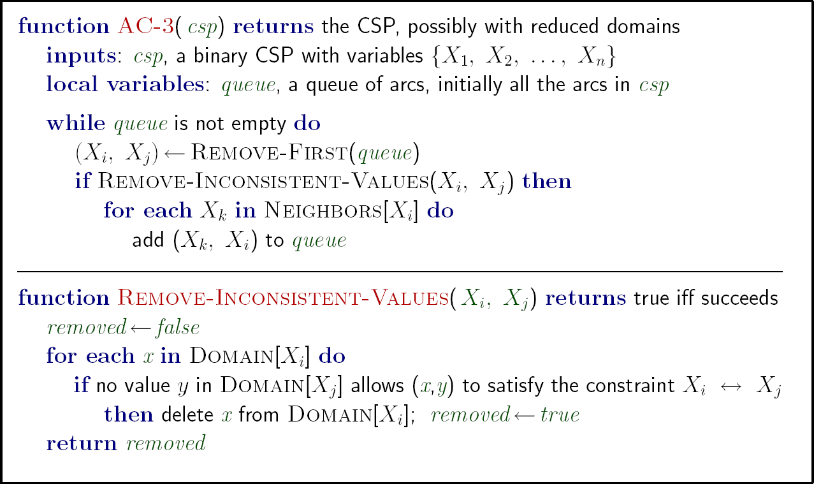


Enforcing Arc Consistency in a CSP
Runtime: O(n²d³), can be reduced to O(n²d²)
… but detecting all possible future problems is NP-hard – why?

Slide 28


Ordering: Minimum Remaining Values
Variable Ordering: Minimum remaining values (MRV):
Choose the variable with the fewest legal values left in its domain
Why min rather than max?
Also called “most constrained variable”
“Fail-fast” ordering

Slide 29
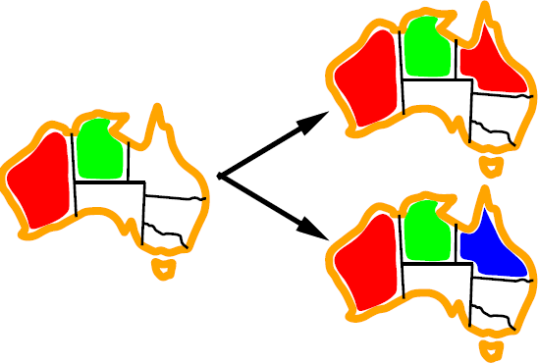

Ordering: Least Constraining Value
Value Ordering: Least Constraining Value
Given a choice of variable, choose the least constraining value
I.e., the one that rules out the fewest values in the remaining variables
Note that it may take some computation to determine this! (E.g., rerunning filtering)
Why least rather than most?
Combining these ordering ideas makes
1000 queens feasible [Demo: coloring – backtracking + AC + ordering]

Slide 30
Limitations of Arc Consistency
After enforcing arc consistency:
Can have one solution left
Can have multiple solutions left
Can have no solutions left (and not know it)
Arc consistency still runs inside a backtracking search!
What went wrong here?

Slide 31
Problem Structure
Extreme case: independent subproblems
Example: Tasmania and mainland do not interact
Independent subproblems are identifiable as connected components of constraint graph
Suppose a graph of n variables can be broken into subproblems of only c variables:
Worst-case solution cost is O((n/c)(d^{c})), linear in n
E.g., n = 80, d = 2, c =20
2⁸⁰ = 4 billion years at 10 million nodes/sec
(4)(2²⁰) = 0.4 seconds at 10 million nodes/sec

Slide 32
Iterative Algorithms for CSPs
Local search methods typically work with “complete” states, i.e., all variables assigned
To apply to CSPs:
Take an assignment with unsatisfied constraints
Operators reassign variable values
No frontiers! Live on the edge.
Algorithm: While not solved,
Variable selection: randomly select any conflicted variable
Value selection: min-conflicts heuristic:
Choose a value that violates the fewest constraints
I.e., hill climb with h(n) = total number of violated constraints

Slide 33
Example: 4-Queens
States: 4 queens in 4 columns (4⁴ = 256 states)
Operators: move queen in column
Goal test: no attacks
Evaluation: c(n) = number of attacks
[Demo: coloring – iterative improvement]
Notes:
L5D1 – python demos
Coloring – javascript demos

Slide 34
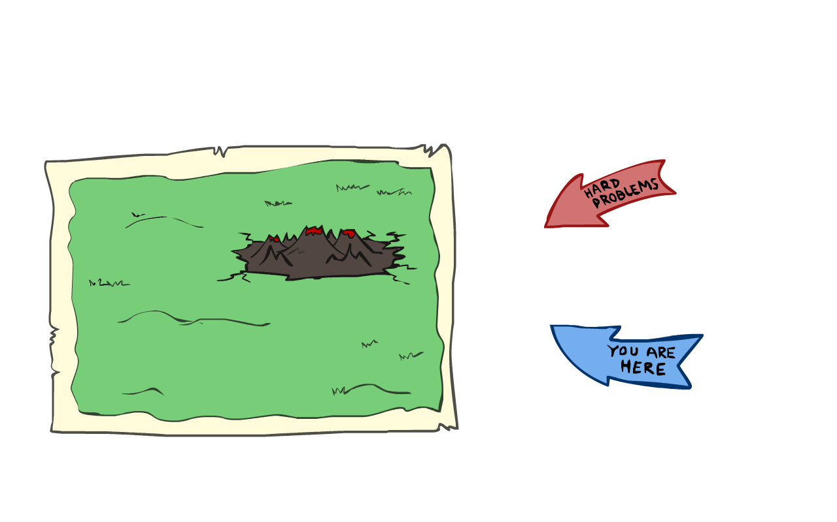
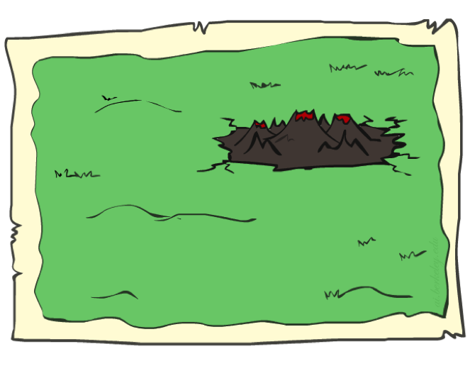
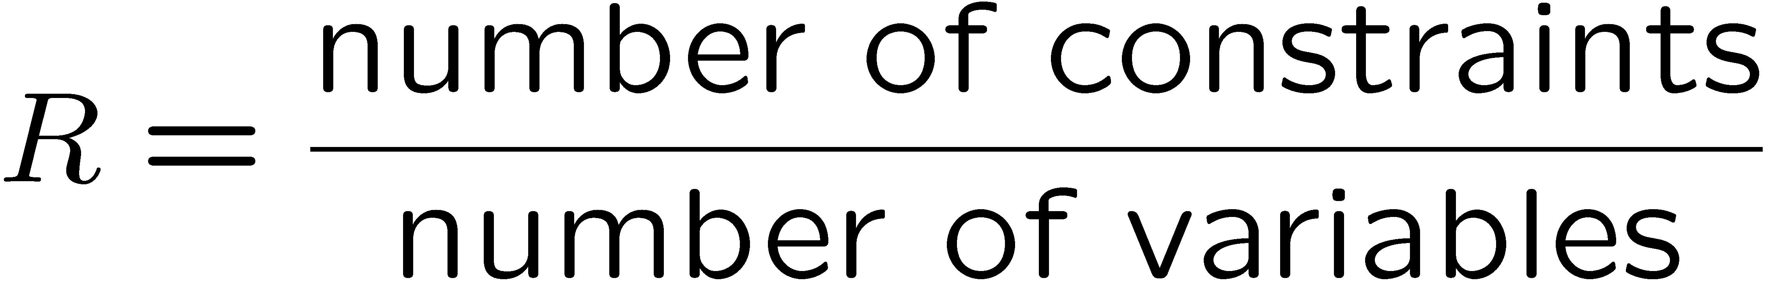
Performance of Min-Conflicts
Given random initial state, can solve n-queens in almost constant time for arbitrary n with high probability (e.g., n = 10,000,000)!
The same appears to be true for any randomly-generated CSP except in a narrow range of the ratio

Slide 35
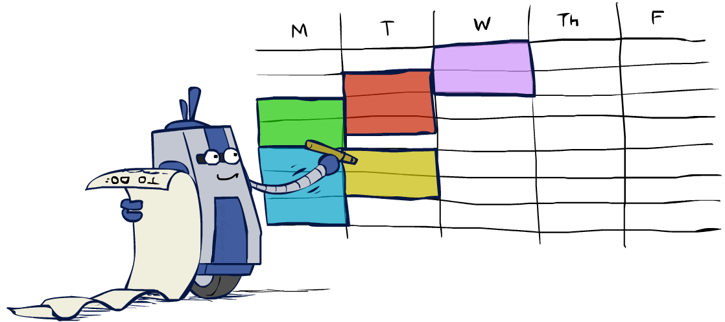
Summary: CSPs
CSPs are a special kind of search problem:
States are partial assignments
Goal test defined by constraints
Basic solution: backtracking search
Speed-ups:
Ordering
Filtering
Structure
Iterative min-conflicts is often effective in practice

Slide 36
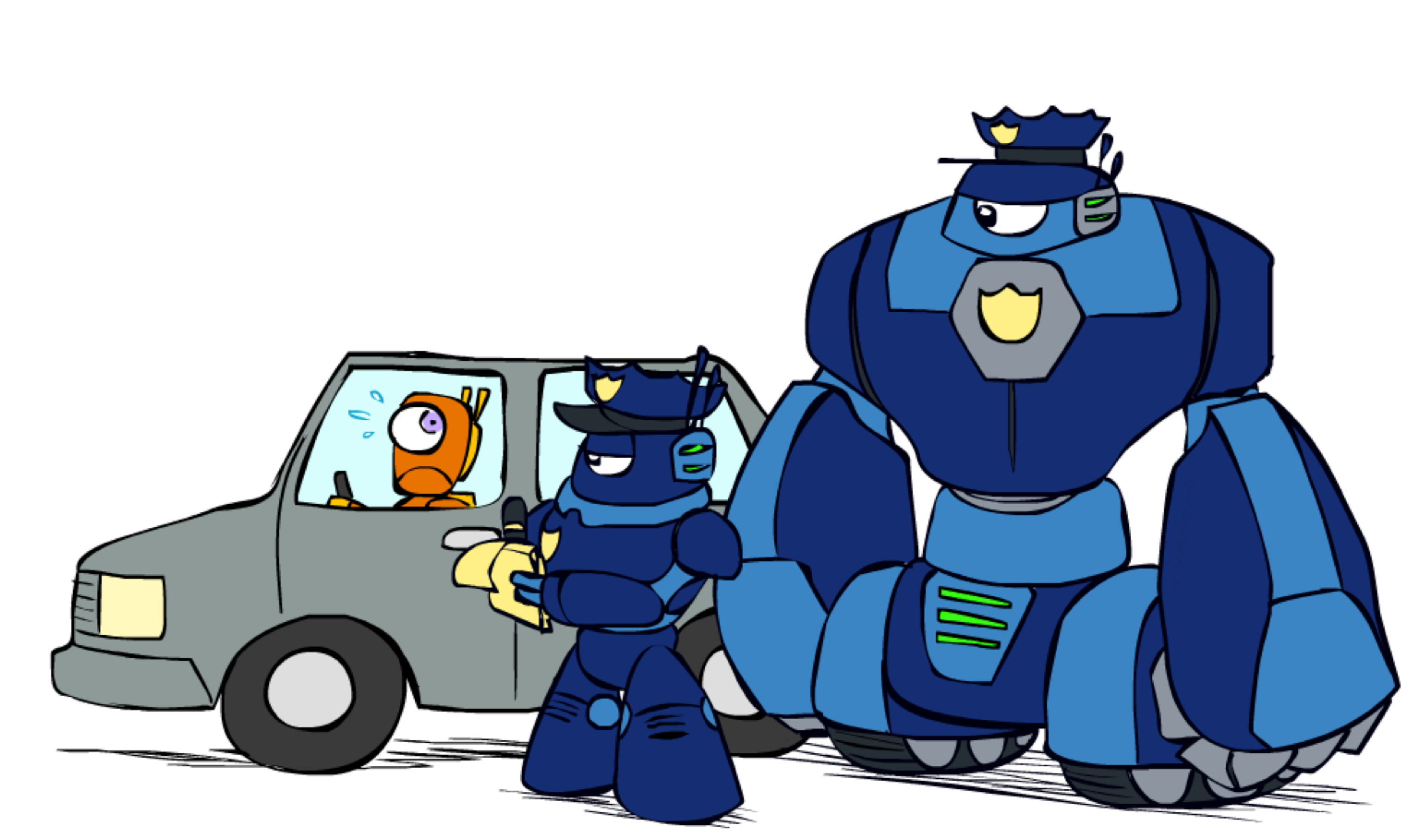
K-Consistency

Slide 37
K-Consistency
Increasing degrees of consistency
1-Consistency (Node Consistency): Each single node’s domain has a value which meets that node’s unary constraints
2-Consistency (Arc Consistency): For each pair of nodes, any consistent assignment to one can be extended to the other
K-Consistency: For each k nodes, any consistent assignment to k-1 can be extended to the k^{th} node.
Higher k more expensive to compute
(You need to know the k=2 case: arc consistency)

Slide 38

Local Search

Slide 39
Local Search
Tree search keeps unexplored alternatives on the frontier (ensures completeness)
Local search: improve a single option until you can’t make it better (no fringe!)
New successor function: local changes
Generally much faster and more memory efficient (but incomplete and suboptimal)

Slide 40
Hill Climbing
Simple, general idea:
Start wherever
Repeat: move to the best neighboring state
If no neighbors better than current, quit
What’s bad about this approach?
Complete?
Optimal?
What’s good about it?

Slide 41
Hill Climbing Diagram

Slide 42
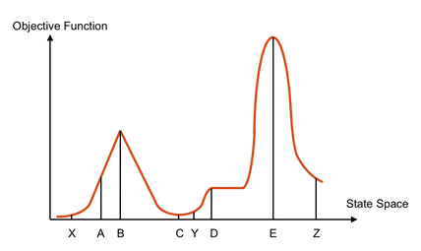
Hill Climbing Quiz
Starting from X, where do you end up ?
Starting from Y, where do you end up ?
Starting from Z, where do you end up ?

